Slide 1
Dark

Slide 2
Ball

Slide 3
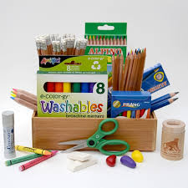
Material

Slide 4
special

Slide 5
Heavy

Slide 6
Fine

Slide 7
Pair

Slide 8
Circle

Slide 9
Include

Slide 10
Built

Slide 11
Thank you

